Slide 2
CNTK on PySpark
Sudarshan Raghunathan
susudars@microsoft.com
Principal SWE Manager, AzureML
(joint work with Miruna Oprescu and Mary Wahl)

Slide 3
Session Goals
Scenarios for scoring and transfer learning on Spark
Spark basics
Setup and configuration
Image ingress into Spark
Model loading and distribution
End-to-end demo
Notes:
This slide is required. Do NOT delete. This should be the first slide after your Title Slide.
This slide should describe what your goals are for this session. This information lets your audience know what you are trying to accomplish with your talk or tutorial—ie, what value will attendees get by investing 25 minutes or 2 hours of their time listening to you.
You should not spend more than 1 minute presenting this slide.
General examples of session goals could be (you will have to create your own specific goals):
Introduce a new technique or approach to solve a customer problem
Compare two approaches and explain why one is superior
Describe a project and the learnings that audience members can apply from it
Teach audience members how to use a specific technology

Slide 4
Spark basics
Framework for distributed computing on large clusters
Fault tolerant
Via “resilient” distributed data and functional programming model
Efficient
Via caching, lazy execution, DAG optimization
Up to 100x faster than Hadoop
Higher order primitives than map and reduce
Convenient bindings in Scala, Python (PySpark) and R
Rich ecosystem of libraries: SQL, ML, Streaming

Slide 5
Spark basics
Spark context and Spark session
“Connection” objects to “resources” that enable distributed execution
RDDs
Fundamental data structure abstraction in Spark
Represents an immutable, partitioned collection of data
Contains methods for operating on data in parallel
“Resiliancy” = “Immutability” + “No side effecting operations”
Data frames
Schematized tabular data structures
Support for SQL queries with query planning and optimization

Slide 6
Common challenges
Setup and installation
Local installation on Windows
Debugging
Failed jobs
Python <-> Java interop
Interop with tools like matplotlib
Performance
Tuning cluster
Optimizing for local cache
No GPU VMs on HDInsight

Slide 7
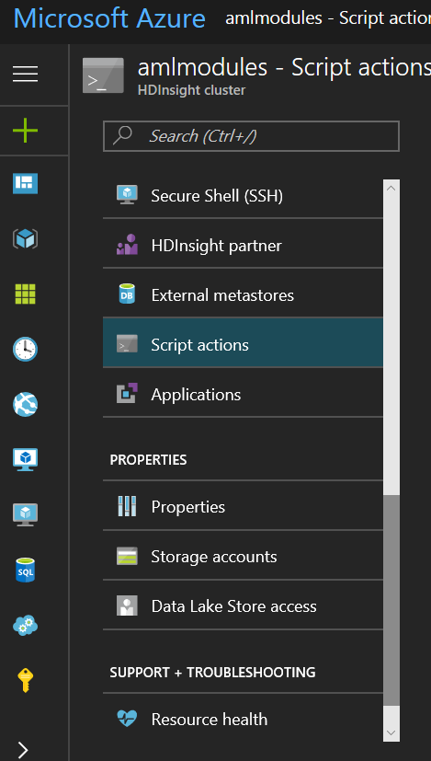
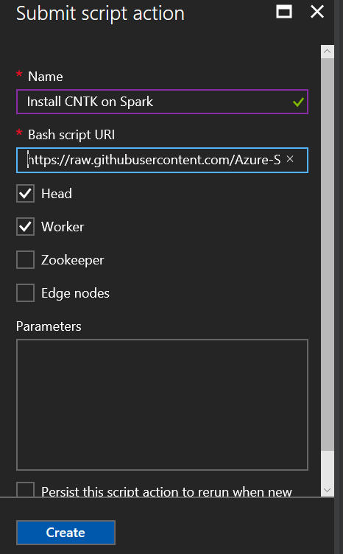
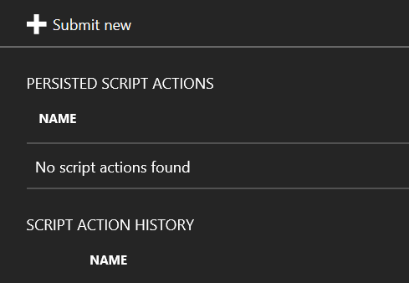
HDInsight script actions

Slide 8
Configuring CNTK on PySpark clusters
HDInsight
http://aka.ms/cntk-hdinsight
Uses a Bash script action to install CNTK on all nodes
Configures Livy and Jupyter kernels
Databricks
http://aka.ms/cntk-databricks
Uses a “init” script to setup CNTK on all nodes
Nodes can be GPU-enabled

Slide 9
Image ingress and pre-processing
“Small” image case:
All image data can be access from a single driver program
Iterate over the collection of arrays in the Python driver program
Use sc.parallelize to distributed it among workers
“Large” image case
Load data in parallel on all workers
Use sc.binaryFiles to read data into byte array, UDFs to parse it into images – OR –
Use sc.parallelize to distribute paths on HDFS to workers
Copy data from HDFS to local directory, use UDFs to load data in parallel

Slide 10
Model loading and distribution
Stage model file to HDFS
Use sc.addFiles to replicate the model to all worker nodes
On each worker, use SparkFiles.get to get the local path to model file
Initialize model from local file inside UDF
Use sc.mapPartitions to only load model once per worker

Slide 11
Demo

Slide 12
Text layout (without bullet points)
Main topic 1: size 36pt
Size 28pt for second level
Size 24pt for third level
Size 22pt for fourth level
Size 22 for fifth level

Slide 13
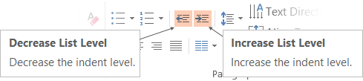
Adjusting list levels
Main topic 1: size 36pt
Size 28pt for second level
Size 24pt for third level
Size 22pt for fourth level
Size 22 for fifth level
Use the “Decrease List Level” and “Increase List Level” tools on the Home Menu to change text levels.
Try this:
Place your cursor in any row of text to the left that says “Size 20pt for subtopics”
Next click the Home tab, and then on the “Decrease List level” tool. Notice how the line moves up one level.
Now try placing your cursor in one of the “Main topic…” lines of text. Click the “Increase List Level” tool and see how the text is pushed in one level
Use these 2 tools to adjust your text levels as you work

Slide 14
Bullet points layout with subtitle Subtitle is smaller in the same text block
Example of a bulleted slide with a subhead
Set the slide title to “Sentence case”
Set subheads to “Sentence case”
Hyperlink style
www.microsoft.com

Slide 15
Photo layout 1

Slide 16
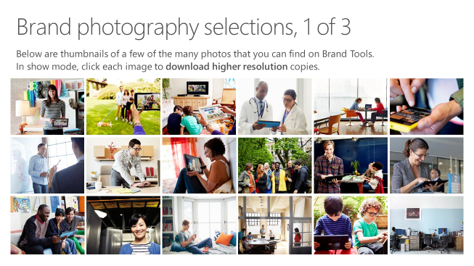
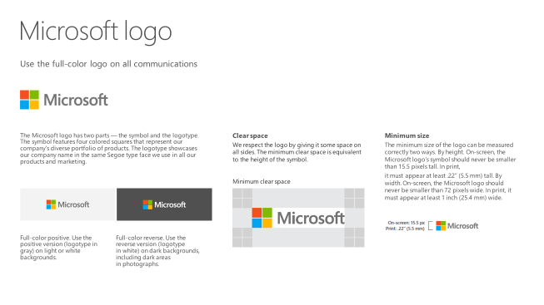
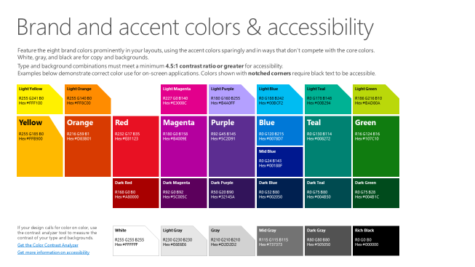
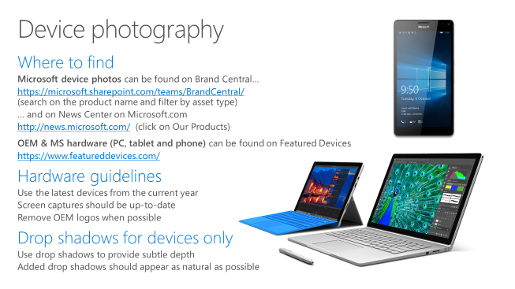
Microsoft brand guidelines
Looking for more slide resources?
Brand guidelines for PowerPoint templates is a separate slide deck that provides an overview of the Microsoft brand, guidelines, resources, tips and much more.
A few of the slides are shown at right.
Download from: https://microsoft.sharepoint.com/teams/BrandCentral/Pages/Presentations.aspx

Slide 17
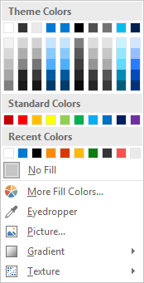
Slide palette info
The PowerPoint palette for this template has been built for you and is shown below. Avoid using too many colors in your presentation.
Accent colors 1-6 – (6 Theme Colors to the far right)
Accent 1
Accent 2
Accent 3
Accent 4
Accent 5
Accent 6
Use Accent 1 as the main accent color. Use Accent 2 and Accent 3 when additional colors are needed.
Use Accents 4-6 sparingly – only when more colors are necessary.

Slide 18
Demo
Speaker name

Slide 19
Video

Slide 20
Section title

Slide 21
Section title

Slide 22
Section title

Slide 23
Software code slide
This slide layout uses Consolas, a monotype font which is ideal for showing software code.

Slide 24
Notes (hidden)
Some speakers at Microsoft like to use this slide for hidden “notes slides”.
Delete it if you don’t want to use it.
NEXT: <next slide title>

